Slide 2
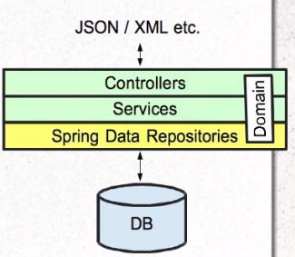
Spring Data - REST
Often applications simply expose DAO methods as REST resources.
Spring DATA REST handles this automatically

Slide 3
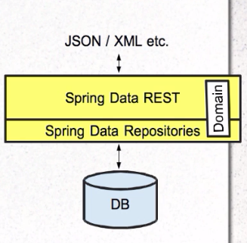
Adding Spring Data REST
Plug into dynamic repositories
Generates RESTful interface:
GET, PUT, POST, DELETE
Code needed only to override defaults

Slide 4
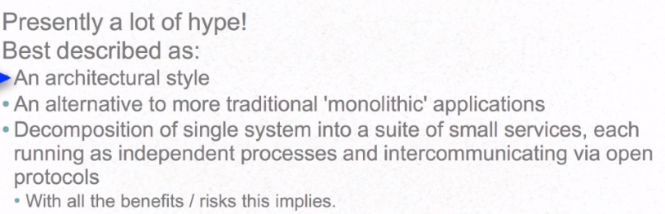
What are Microservices

Slide 5
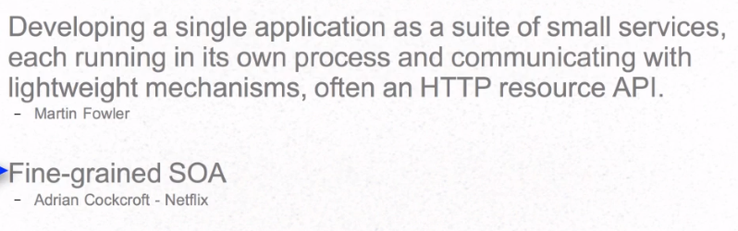
Definitions From Experts

Slide 6
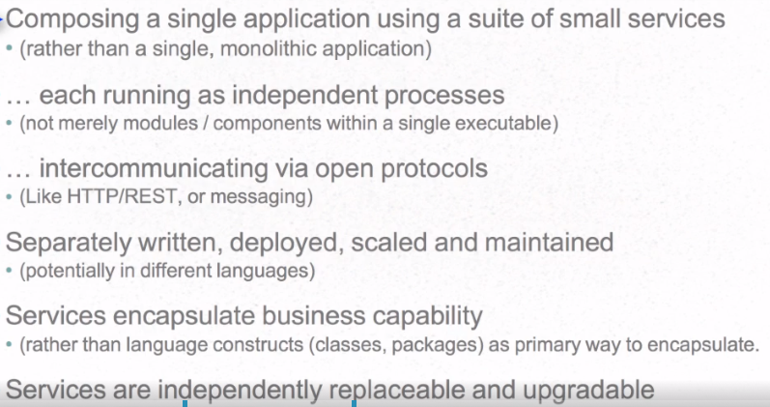
Microservices-Working Definitions

Slide 7
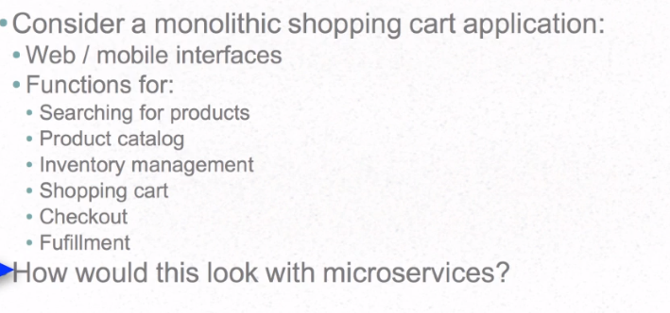
Microservices Example

Slide 8
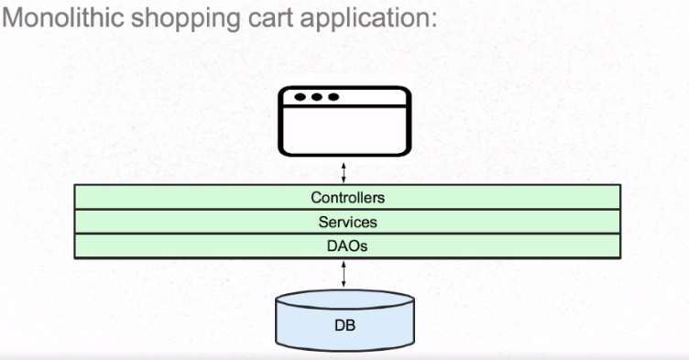
Monolithic Application

Slide 9
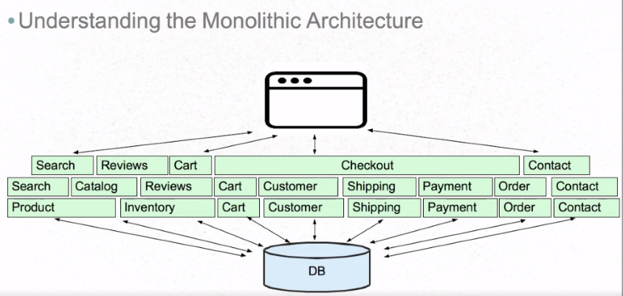
Monolithic Architecture

Slide 10
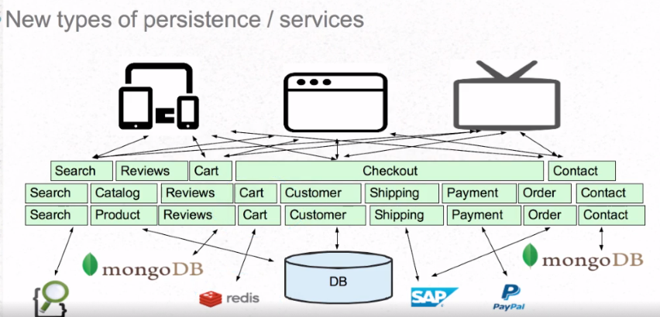
Monolithic Challenges

Slide 11
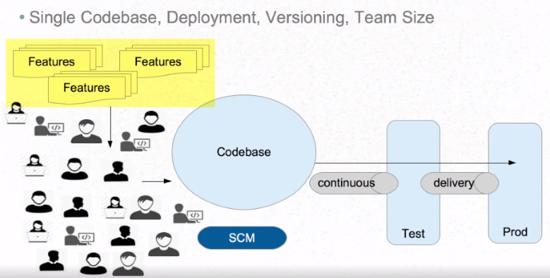
Monolithic Challenges

Slide 12
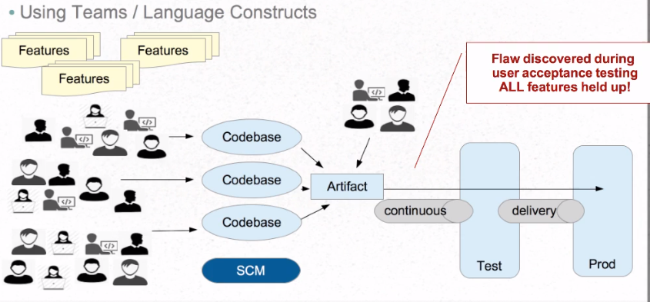
Monolithic Challenges

Slide 13
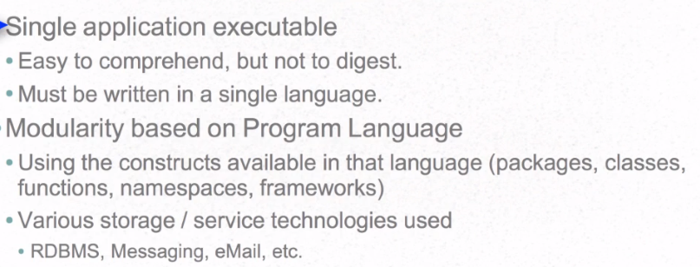
Understanding the Monolithic Implementation

Slide 14
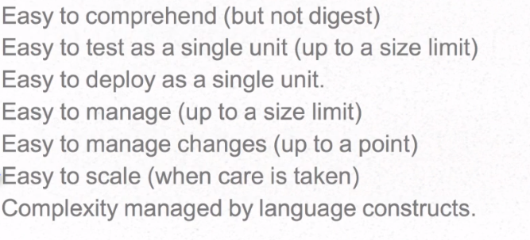
Monolithic Advantages

Slide 15
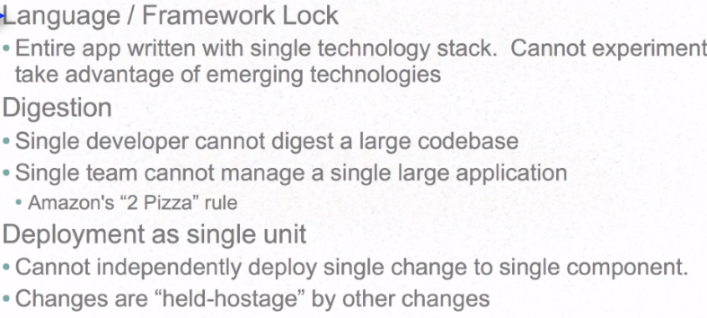
Monolithic Disadvantages

Slide 16
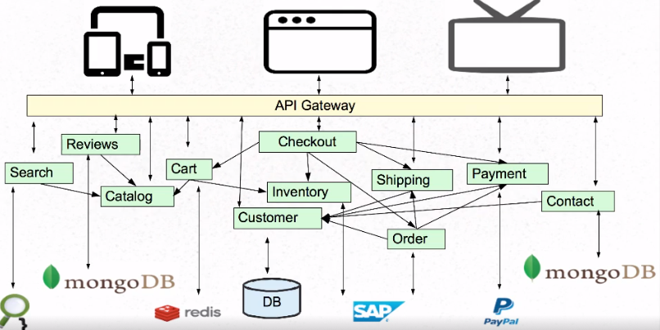
Microservices Architecture

Slide 17
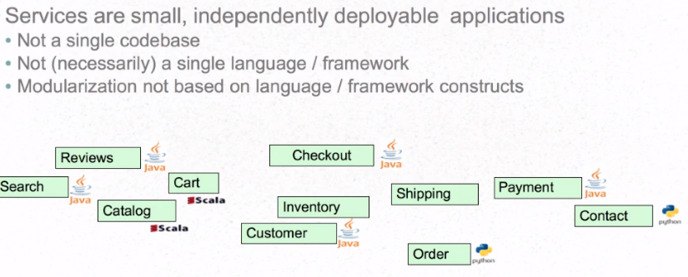
Microservices Services
Composed using suite of small services

Slide 18
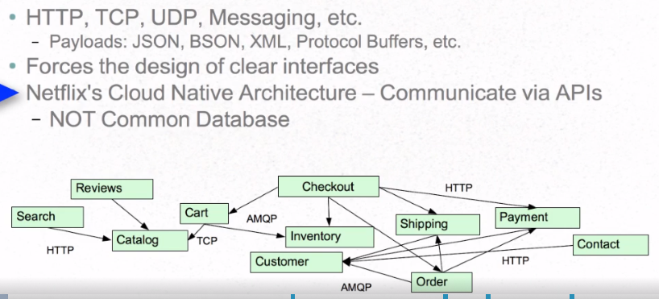
Microservice Communication
Based on lightweight protocol

Slide 19
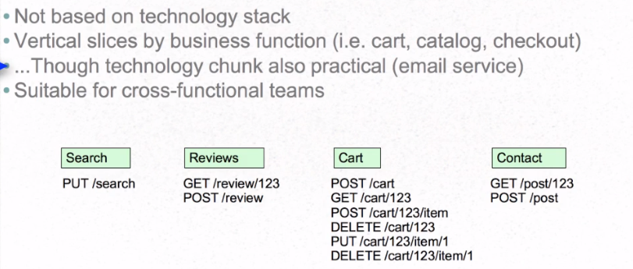
Microservices: Capabilities
Services encapsulate business capabilities

Slide 20
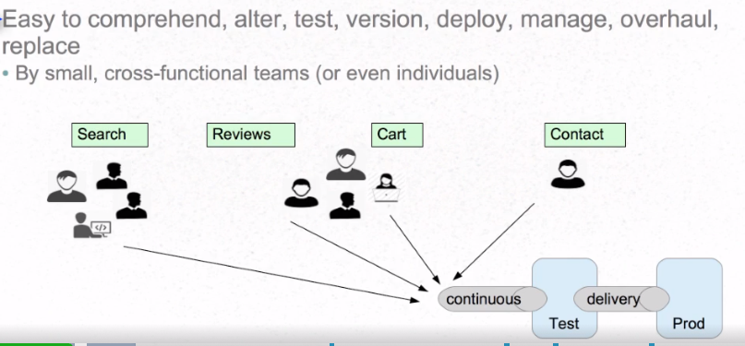
Microservices: Managable
Services easily managed

Slide 21
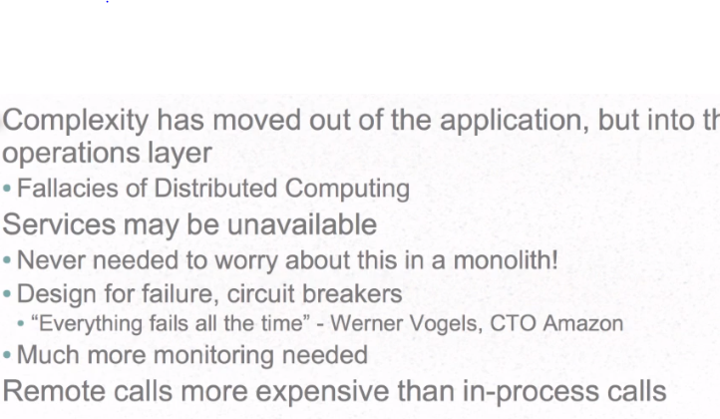
Challenges with Microservices

Slide 22
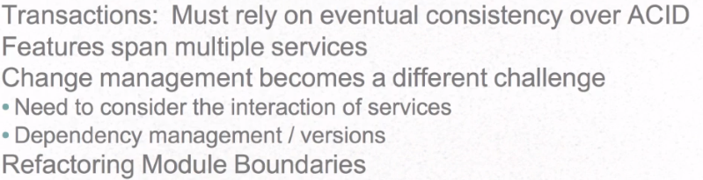
Challenges with Microservices

Slide 23
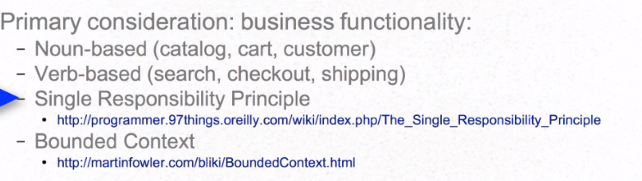
How to break Monolithic into Microservices

Slide 24
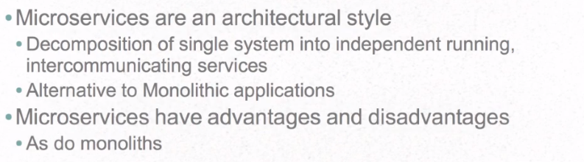
Summary

Slide 25
Spring Cloud
Addressing the issues found in cloud-native applications

Slide 26
Spring Cloud Origins
First, there was the Spring Framework (2004)
Alternative to low-level JEE approaches
Next, Spring sub-projects emerged (2006 – present)

Slide 27
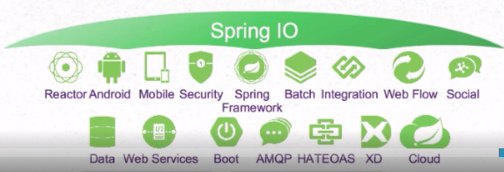
Spring Cloud Origins
Organized under Spring IO umbrella:

Slide 28
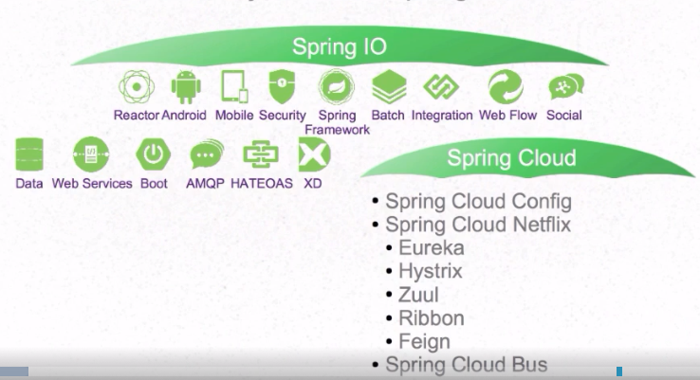
Spring Cloud Subproject
“Sub-Umbrella” Project within Spring IO platform

Slide 29
Goal of Spring Cloud
Provide libraries to apply common patterns needed in distributed applications
Distributed/Versioned/Centralized Configuration management
Service Registration and Discovery
Load Balancing
Service-to-Service calls
Circuit Breakers
Routing

